Slide 1
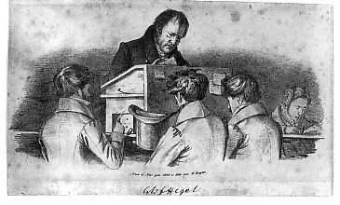

Slide 2
Tarih Felsefesi I
Devlet, Tanrı’nın yeryüzündeki yürüyüşüdür. Devlet’in temeli, kendisini irade olarak gerçekleştiren aklın gücüdür. Devlet fikri, herhangi bir özel Devleti ya da kurumu çağrıştırmamalıdır.
Burada, Devlet’ten söz edilince, daha ziyade, Fikrin kendisi, bu fiili Tanrı dikkate alınmalıdır. Zira kusurları bulmak, pozitif anlamı kavramaktan daha kolay olduğu için, insan, Devlet’in iç organik özünü gözardı edecek kadar, Devlet’in özel yapısına ya da niteliğine vurgu yapma yanlışına düşebiliyor kolaylıkla. Tarih Felsefesi 1. YSK

Slide 3
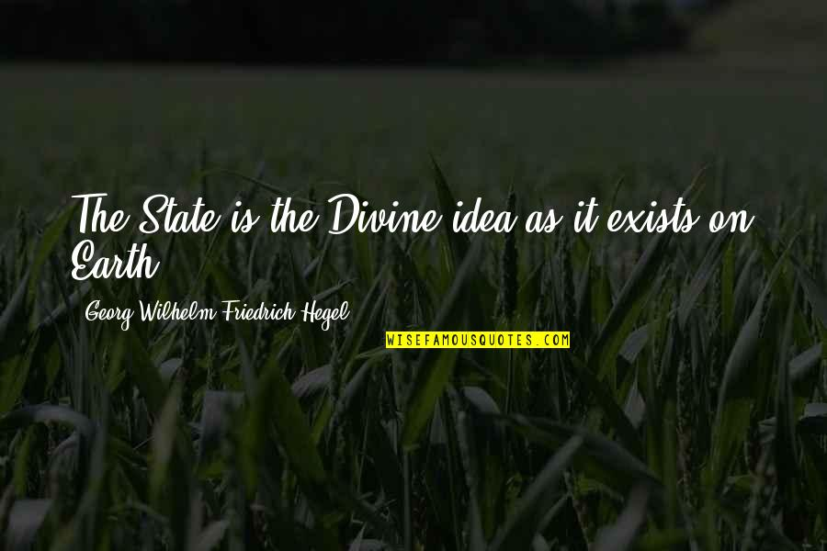

Slide 4
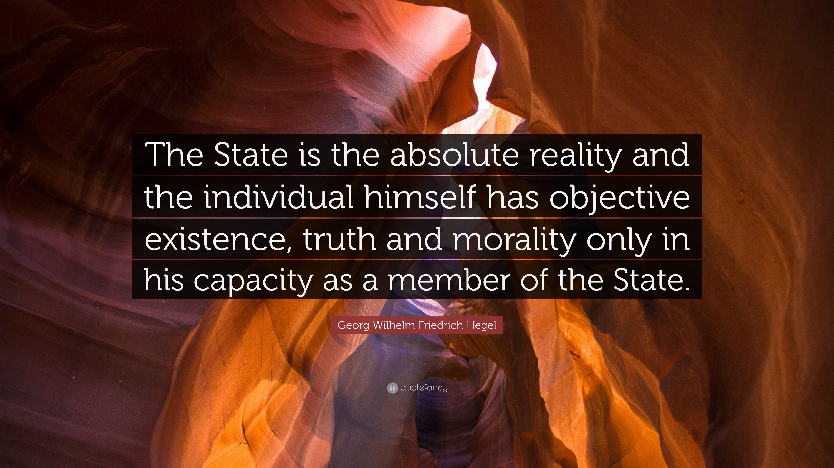

Slide 5
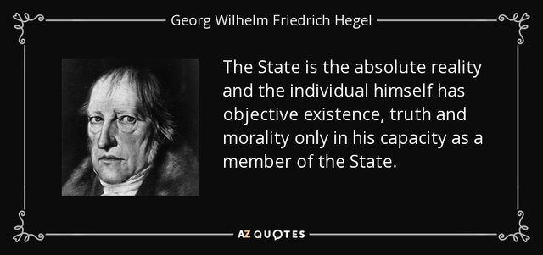

Slide 6
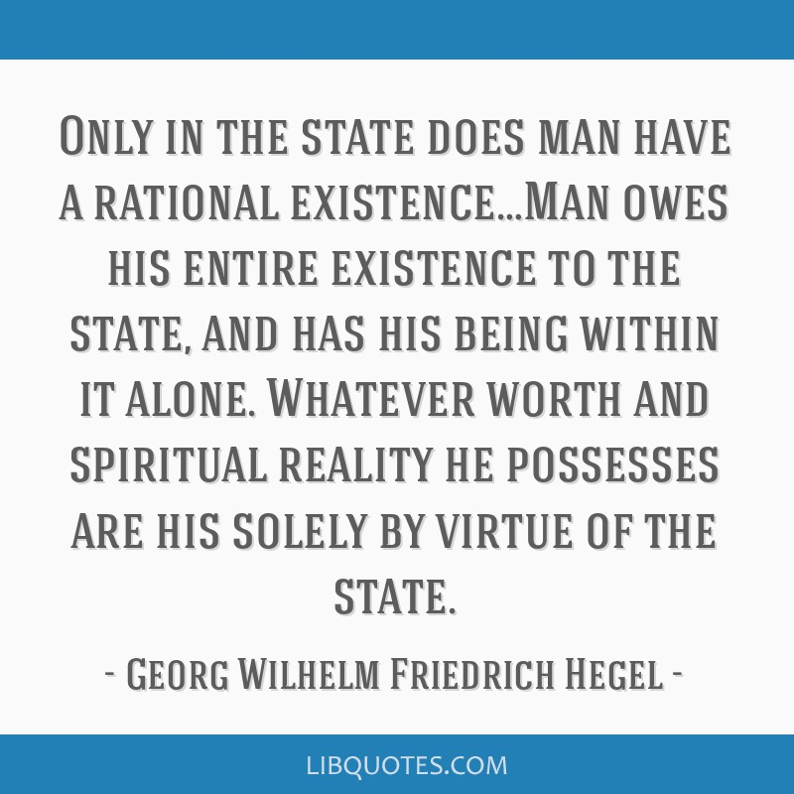

Slide 7


Slide 8
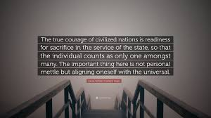

Slide 9
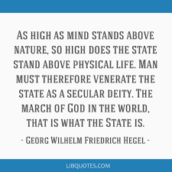

Slide 10
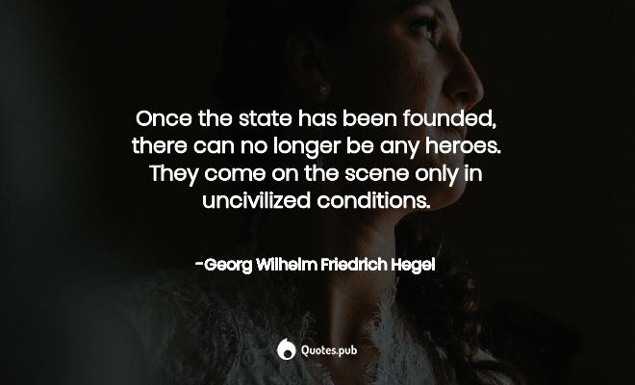

Slide 11


Slide 13
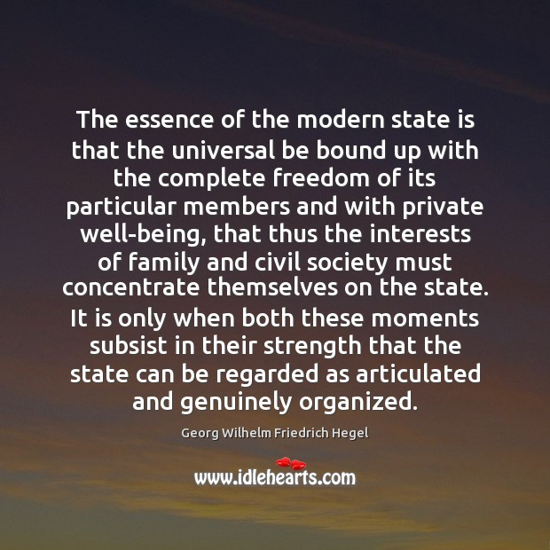

Slide 14
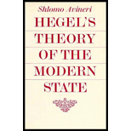

Slide 15
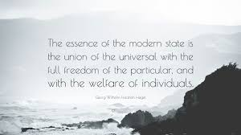

Slide 16
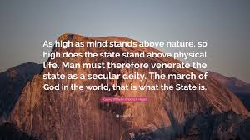

Slide 17


Slide 18
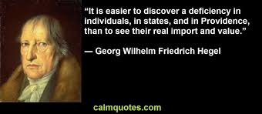

Slide 19
Philosophy of Right 257
The state is the actuality of the ethical Idea. It is ethical mind qua the substantial will manifest and revealed to itself, knowing and thinking itself, accomplishing what it knows and in so far as it knows it.
The state exists immediately in custom, mediately in individual self-consciousness, knowledge, and activity, while self-consciousness in virtue of its sentiment towards the state, finds in the state, as its essence and the end-product of its activity, its substantive freedom.

Slide 20
Ph Right § 258
The state is absolutely rational inasmuch as it is the actuality of the substantial will which it possesses in the particular self-consciousness once that consciousness has been raised to consciousness of its universality.
This substantial unity is an absolute unmoved end in itself, in which freedom comes into its supreme right. On the other hand this final end has supreme right against the individual, whose supreme duty is to be a member of the state.

Slide 21
Ph of Right 258
The state in and by itself is the ethical whole, the actualisation of freedom; and it is an absolute end of reason that freedom should be actual. The state is mind on earth and consciously realising itself there. In nature, on the other hand, mind actualises itself only as its own other, as mind asleep.
Only when it is present in consciousness, when it knows itself as a really existent object, is it the state. In considering freedom, the starting-point must be not individuality, the single self-consciousness, but only the essence of self-consciousness; for whether man knows it or not, this essence is externally realised as a self-subsistent power in which single individuals are only moments. The march of God in the world, that is what the state is.

Slide 22
Ph of Right 258
The basis of the state is the power of reason actualising itself as will. In considering the Idea of the state, we must not have our eyes on particular states or on particular institutions. Instead we must consider the Idea, this actual God, by itself. On some principle or other, any state may be shown to be bad, this or that defect may be found in it; and yet, at any rate if one of the mature states of our epoch is in question, it has in it the moments essential to the existence of the state.
But since it is easier to find defects than to understand the affirmative, we may readily fall into the mistake of looking at isolated aspects of the state and so forgetting its inward organic life. The state is no ideal work of art; it stands on earth and so in the sphere of caprice, chance, and error, and bad behaviour may disfigure it in many respects. But the ugliest of men, or a criminal, or an invalid, or a cripple, is still always a living man. The affirmative, life, subsists despite his defects, and it is this affirmative factor which is our theme here.

Slide 23
§ 259
The Idea of the state:
(A) has immediate actuality and is the individual state as a self-dependent organism – the Constitution or Constitutional Law;
(B) passes over into the relation of one state to other states – International Law;
(C) is the universal Idea as a genus and as an absolute power over individual states – the mind which gives itself its actuality in the process of World-History.

Slide 24
§ 260
The state is the actuality of concrete freedom.
But concrete freedom consists in this, that personal individuality and its particular interests not only achieve their complete development and gain explicit recognition for their right (as they do in the sphere of the family and civil society) but, for one thing, they also pass over of their own accord into the interest of the universal, and, for another thing, they know and will the universal; they even recognise it as their own substantive mind; they take it as their end and aim and are active in its pursuit.

Slide 25
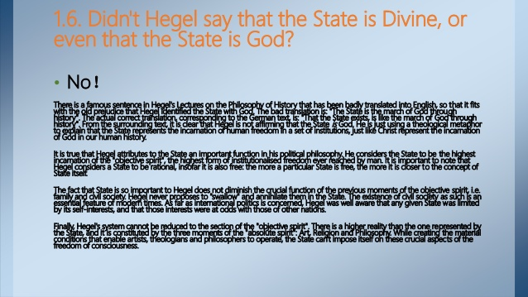

Slide 26
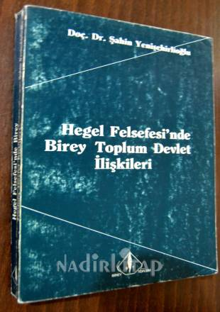

Slide 27
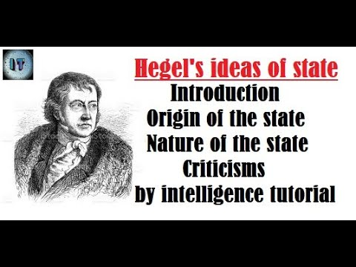

Slide 28
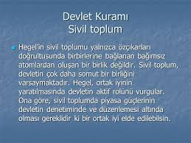

Slide 29
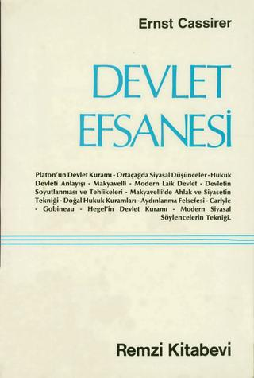

Slide 30
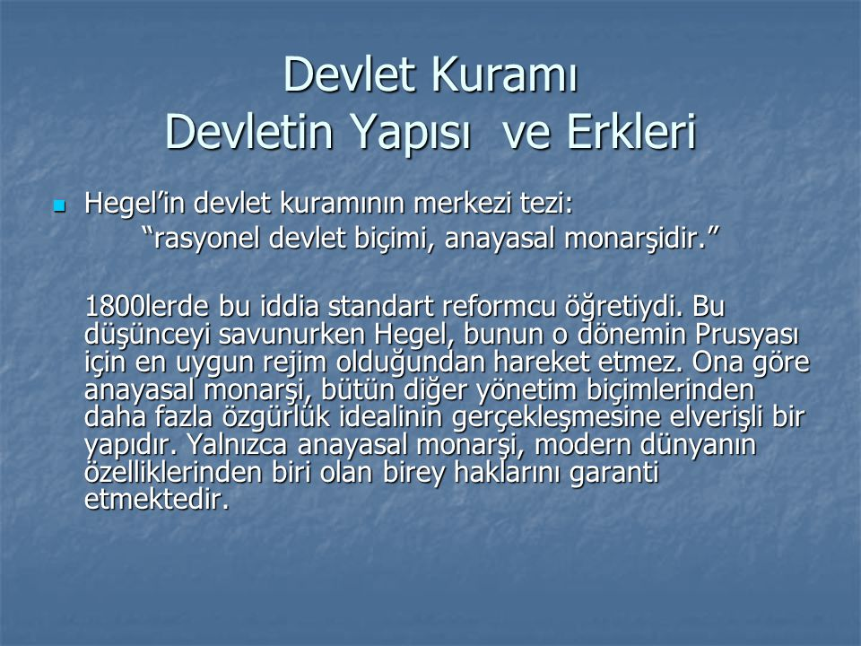

Slide 31
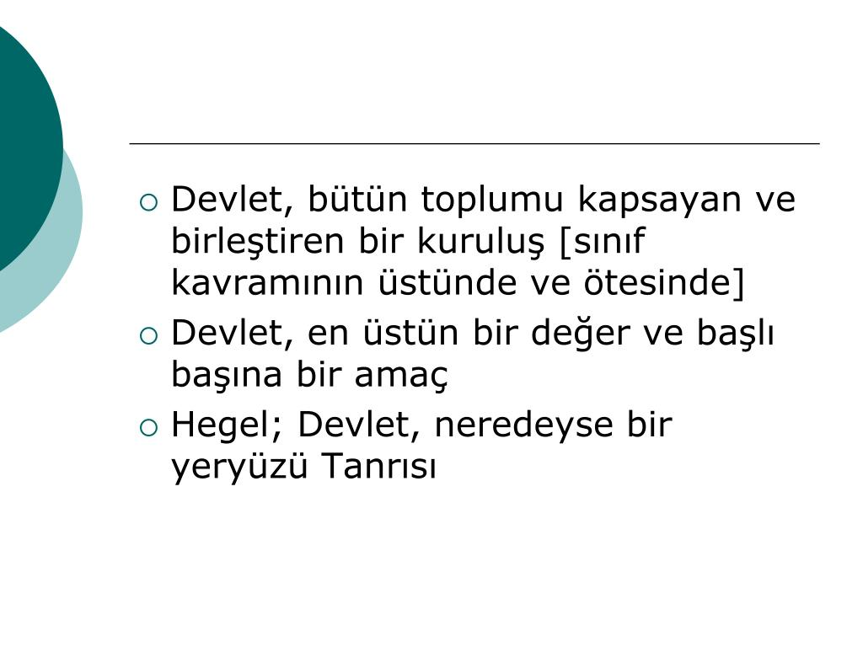

Slide 32
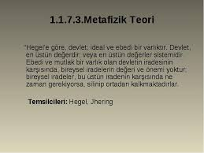

Slide 33
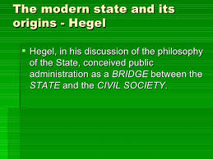

Slide 34


